Slide 1



Sales Performance & Customer Insights
Data-Driven Decisions for Better Customer Experience GROUP – H

Slide 2

The Challenge
Too many products
Customers get lost in choices
Lost opportunities

Slide 3

Customer Journey Snapshot
Browse → Choose → Buy
Pain point: Choosing

Slide 4



Why It Matters
Lost sales
01
MORE RETURNS
02
FRUSTATED CUSTOMERS
03

Slide 5



Our Goal
Find out :
“What sells”
“When it sells”
“Who buys it”

Slide 6

The Data
Articles data (products)
Customers data (age, loyalty)
Transactions data (sales history)

Slide 7

Data Preparation
Removed null values
Fixed formats
Merged datasets

Slide 8
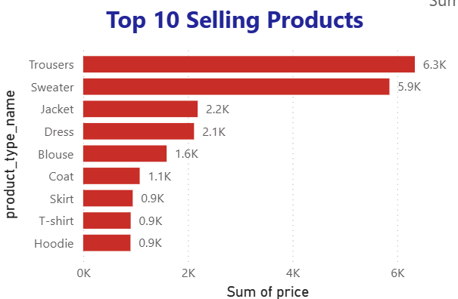
Insight 1: Best Sellers
Trousers & sweaters lead
Jackets & dresses

Slide 9
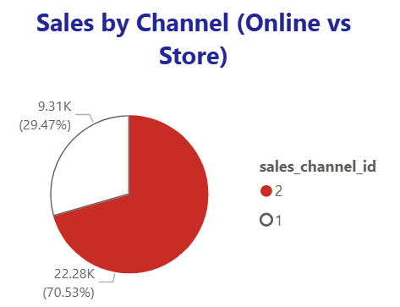
Insight 2: Where People Buy
70% Store
30% Online

Slide 10
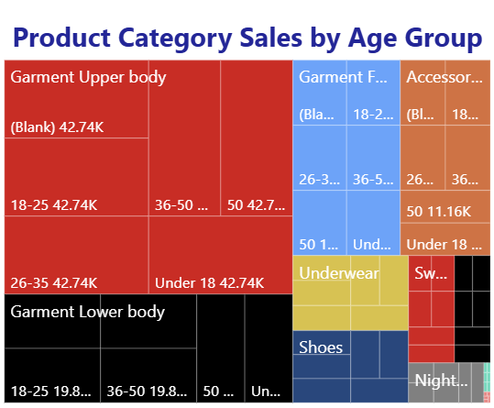
Insight 3: Who’s Buying
18–35 years = biggest buyers

Slide 11
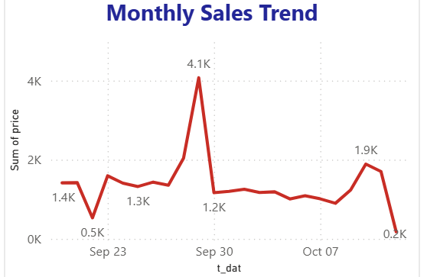
Insight 4: Seasonal Trends
Peak in September

Slide 12
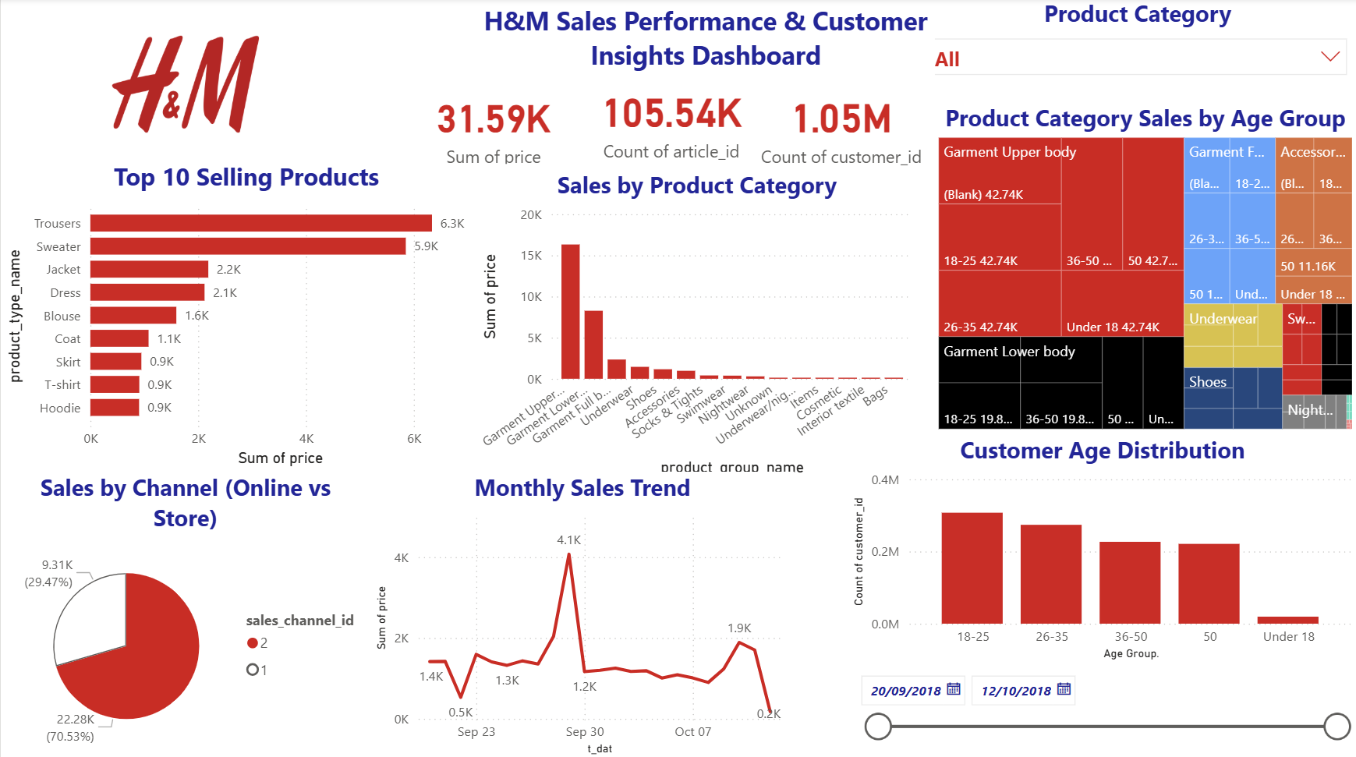
DASHBOARD

Slide 13



Benefits of This Analysis
Higher sales
Fewer returns
Better targeting

Slide 14

Opportunities & Actions
Promote top sellers
Target young Adults
Plan for Seasonal Peaks
Grow Online Sales

Slide 15

“The right data leads to the right decisions” Thank you!

